Slide 1



FACILITATE OUTGOING PHONE CALLS
D1.HFO.CL2.10
Notes:
Trainer welcomes the trainees and informs them that they will be learning how to facilitate outgoing phone calls.

Slide 2
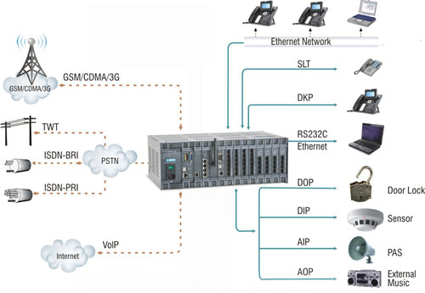
Element 1: Identify elements and facilities of the host enterprise telephone system
Notes:
Trainer advises students this element identifies the elements and facilities of the host enterprise telephone system.

Slide 3

1.1 Identify the types of outgoing calls that may be made and their importance to the business
Types of outgoing calls
Contacting suppliers
Contacting emergency services
Fire
Ambulance/doctor
Police
(Continued)
Notes:
Discuss the types of outgoing calls
Contacting suppliers – when and who do you need to talk to?
Emergency services:
What do you do when you have to contact the fire, ambulance and police?

Slide 4
1.1 Identify the types of outgoing calls that may be made and their importance to the business
Placing personal or private calls
Marketing and sales activity
Confirming reservations
Making reservations
Follow up
Responding to complaints
Returning calls
Notes:
Placing personal or private calls – often guests are unable to use the equipment and get help from the operator
Discuss the information you would need to get from the guest to make a call.

Slide 5

Class exercise
Discuss the forms of marketing and sales activities you have received on your mobile phones or what you could be receiving
Break into groups of 3 - 4
Present the group findings to the class for further discussion
Notes:
Break the class into groups of 3 - 4 and get them to discuss the types of sales and marketing messages they get on their phones e.g. advertising from their favourite clothing store, supermarket and other retail shop specials.
You could also include confirmations you receive - the dentist, your hairdresser, your doctor, having the car serviced.

Slide 6

1.2 Identify components of the telephone system
Mobile phones
Paging systems
Switchboards
Handsets and headsets
Caller identification
Notes:
Discuss how mobile phones are so widely used. Discuss the fact that they are so portable – especially for resorts and hotels with a lot of land
Discuss paging systems – probably phasing out now because of cheaper mobiles
Switchboards – how they have changed over the years from the hooks and wires to the automatic small switchboards we have today
Handset and head sets. Ask the class if any one has worked using one of these – McDonalds is famous for its use of headsets in the drive-thru.

Slide 7
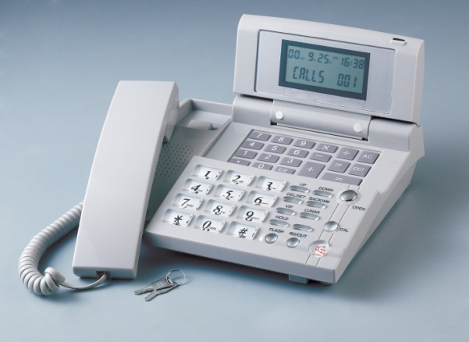
1.3 Describe the functions and features available in a telephone system
Phones today have come a long way from the early days of the telephone:
Caller ID
Call return
Transfer calls
Multiple chat – conference calls
Speed dial
Automatic re-dial
Call waiting
Notes:
Discuss the changes in personal phones in the life time of the trainees e.g. cameras, GPS settings, maps to get directions, the introduction of Apps, loyalty cards for coffee, paying your parking meter – all stored on your phone.
Discuss how quickly these changes have occurred. What do you think will come next?
Discuss what is available for business use; follow the points on the slide

Slide 8

Element 2: Demonstrate appropriate telephone communication skills
Notes:
Trainer advises students this element identifies appropriate telephone communication skills.

Slide 9

2.1 Interpret the enterprise policies and procedures for telephone use in regard to outgoing calls
Policies and procedures:
Privacy and confidentiality
Response to threatening or suspicious calls
Authorisation to use the system and nominated elements
Using communications tools for personal use
Costing of calls
Notes:
Discuss the importance of privacy and confidentiality the staff have to the house guests. You are in possession of a lot of information about guests and must be extremely sensitive about what you do with it
Being on reception or a telephonist you will have to act upon receiving a threatening or suspicious call. The most important thing is to remain calm.
Discuss with the class – who are you likely to call?
Personal phone calls are restricted – even when you are using your own mobile. Discuss the protocol of using your mobile phone at work.
Not all staff are authorised to use all the features on the telephone system. Pagers, for instance, might be the duty of the supervisor not the staff.
Point out to the class how guest calls are costed and any extra charges that are included; discuss how mobiles have changed this.

Slide 10

Standard phrases
What should a standard phrase include:
Greeting
Identification
Assistance
Notes:
Discuss the standard phrases to answer a call
Suitable greeting
Identification of the establishment and the operator
Offer any assistance you can – or transfer call to someone who can help.

Slide 11
Class activity
Students in pairs – working back to back (no eye contact):
Staff - answer a call – appropriately
Guest - invent an issue you need discussed or follow the situations from your teacher
Swap roles
Notes:
Teacher should prepare the issues, for example:
1) Guest wants to make a reservation for dinner
2) Guest gives their name e.g. Mr. Blewitt, and wants speak to someone in the lounge bar
Check that the telephone operator uses the guest’s name.
Will the call be transferred? Or the guest paged?

Slide 12

2.2 Differentiate between face to face and over the phone communications
What are the differences between these 2 forms of communication?
Notes:
Discuss the factors that make a difference between the 2 forms of communication
Get the class to contribute to this topic
Immediate response
Cannot see any expressions
No eye contact
Difficulty of accents or language barrier – no actions available
Use of questioning skills.

Slide 13

2.3 Appropriate telephone communication skills
Positive attitude and speaking skills
Use your voice effectively
Apply listening and questioning skills
Respond professionally
Notes:
What does it mean to have a ‘positive attitude’? Discuss with the class
Need to feel comfortable in your job – you need to feel like “you know your stuff”
Well trained on the equipment and product knowledge
Know what are the best phrases to use
Avoid jargon
Don’t use too many words
Avoid slang.
Be aware of your voice – too soft too loud ? Rate you speak – monotone and pitch
Your posture
Be professional – put a smile on your voice
Listening and questioning skills – discuss with class
Professional response – not YEAH – yes, discuss other words with the class that shouldn’t be used.

Slide 14

2.4 Appropriate telephone techniques
Clarify caller requirements
Repeat names and dates
Use phonetic alphabet
Notes:
Discuss how important it is to clarify the caller’s requirements – this requires that you LISTEN
Repeat back names and dates and times – remind them of the 24 hour clock
Discuss the benefits of using the phonetic alphabet.

Slide 15
Class activity
Phonetic alphabet
Work out how you would spell your full name in the phonetic alphabet
Record this and make sure you use it next time you have to spell your name
Write out the 24 hour clock details – get into the habit of using this as well
Make up a sentence with your name in it and practice it with the person next to you. Include the time in 24hr format. (Back to back – no eye contact)
Notes:
This activity is to get the students to feel comfortable with the use of the phonetic alphabet and 24 hour clock.

Slide 16

2.5 Acceptable telephone etiquette
List the 13 points of telephone etiquette:
Notes:
What is telephone etiquette? Ask the students to talk about this before, discussing the 13 points:
Answer the call within the second or third ring
Always speak clearly and slowly
Avoid extreme volumes
Avoid jargon or hotel terminology
Speak with a smile on your face
Use an appropriate opening phrase
Repeat the details back to the guest
Always use the caller's name if known, otherwise, sir or madam
Ask how something is spelt if you cant understand
Transfer calls promptly
Never eat, drink or smoke while on the phone
Use a suitable closing phrase - thank the caller for calling
Always allow the caller to hang up first.

Slide 17

Element 3: Place outgoing calls on behalf of the enterprise
Notes:
Trainer advises students this element identifies the placement of outgoing calls on behalf of the enterprise.

Slide 18
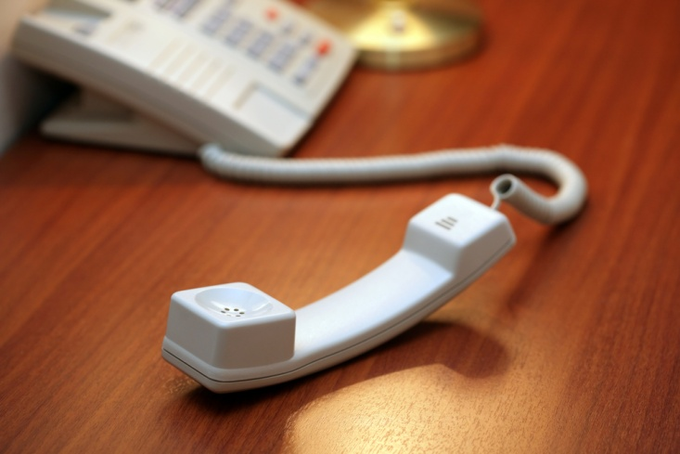
3.1 Obtain required telephone number and details of business/person to be called
Outgoing call numbers:
Extension numbers
Client directories
Directories
Directory assistance
Notes:
Discuss how you would obtain the required number for a business or person to be called
Could also include the use of the internet.

Slide 19

3.2 Determine the purpose of the call
Returning a call
Making an enquiry
Seeking information
Selling and marketing activity
Notes:
Discuss with the student why you would need to determine the purpose of the call
Discuss the individual points on the slide in relation to the purpose of the call.

Slide 20
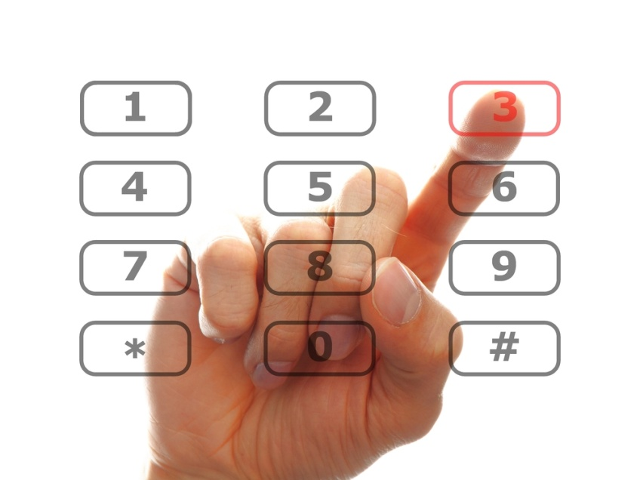
3.3 Place call and establish contact with required business or person
Establish contact to the number requested:
Is it the correct number?
Notes:
Discuss the avenue of placing a call and make sure it is the person or business requested by the caller
How will you know if it is the correct number?

Slide 21

3.4 Explain the purpose of the call
Returning a call
Making an enquiry
Seeking information
Selling and marketing activity
Notes:
Discuss the following points in relation to placing a call on behalf of an enterprise.

Slide 22
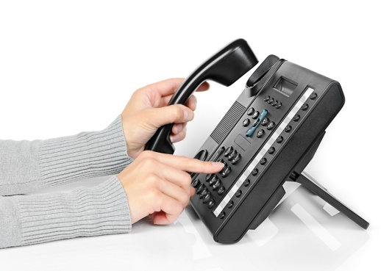
3.5 Transfer connected call to caller
Procedure to transfer a call to the caller:
Let the caller know you are making the call on another person’s behalf
Put them on hold
Speak to your guest – let them know you have their caller
Put the call through
Notes:
Discuss this procedure
Keep everyone informed of what is happening
Discuss the essential element of knowing the equipment you are using. How do you put people on hold (don’t cut them off)? How do you open up the line to speak again?

Slide 23
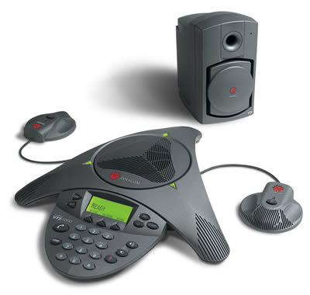
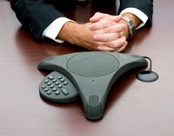
3.6 Facilitate conference calls
Benefits to conference calls:
Before the call
During the call
After the call
Notes:
Discuss why we use a conference call – what are the benefits?
Discuss these three aspects and how important they are to the process of the conference call
Know the equipment and how to use if effectively.

Slide 24
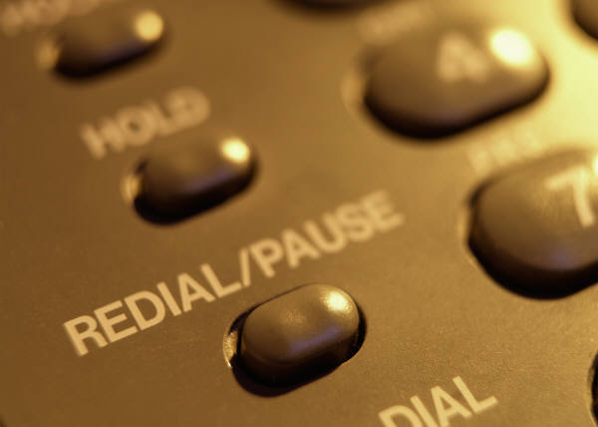
3.7 Implement standard redial procedures as required
Re-dial procedures:
Re-dial function
Automatic re-dial
Notes:
Discuss the benefits of the redial function
Discuss the benefits of automatic redial.

Slide 25
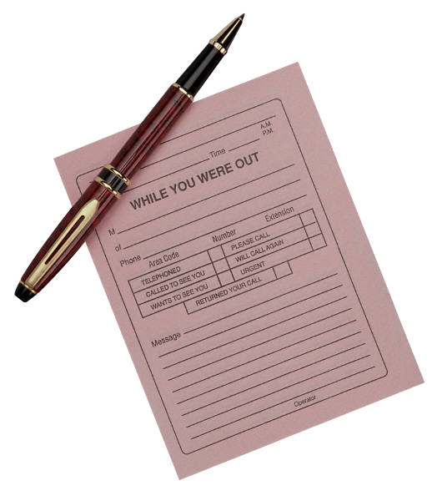
3.8 Log details of call in accordance with enterprise procedures
Log call details:
Date and time
Details of overseas calls
Name of person/business called
Duration of call
Guest name and room number
Notes:
Demonstrate that you don’t have to log calls if you have a PMS that will automatically log and charge the guest for the calls made
Manual process to log calls – what needs to be logged?

Slide 26
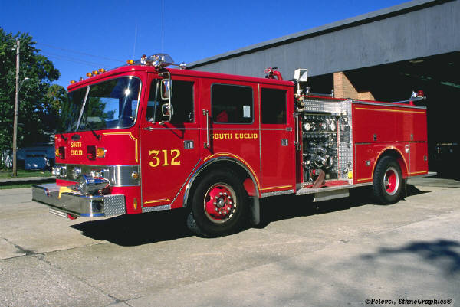


3.9 Place emergency calls
Identify the nature of the emergency:
Fire
Ambulance/doctor
Police
Notes:
Discuss with the class how you would identify which service to call
How would you be notified of an incident?

Slide 27
Class activity
Prepare a card with all the local emergency services in your city:
Direct emergency number of your city e.g.: 000
Include the phone numbers – extensions if you use them
Address of the services
Contact names if you have them
Notes:
Get the class to prepare an emergency card for all the services in their city
This adds to the student’s awareness of the emergency facilities. What is available, where it is and how you contact them.

Slide 28
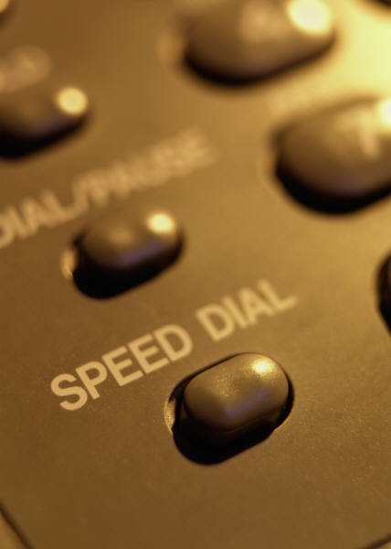
3.10 Enter commonly called numbers into system speed-dial facility
Benefits of speed dialing:
Know you phone system
Pre-set numbers
Notes:
Discuss the benefits of speed dialing
How does this work?
What sort of numbers would you put into the presets?

Slide 29
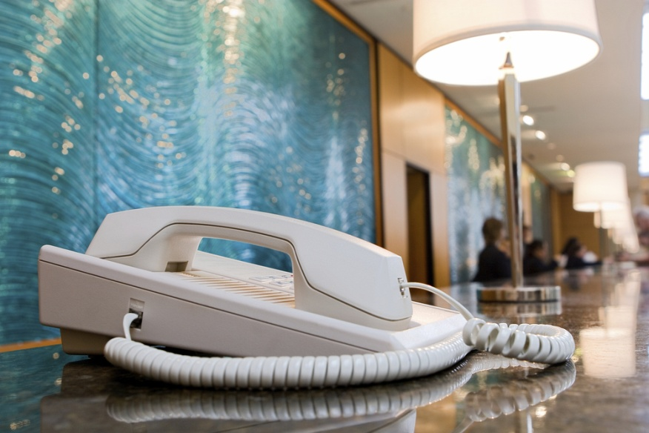
Element 4: Place outgoing calls on behalf of guests
Notes:
Trainer advises students this element identifies the placement of outgoing calls on behalf of guests.

Slide 30
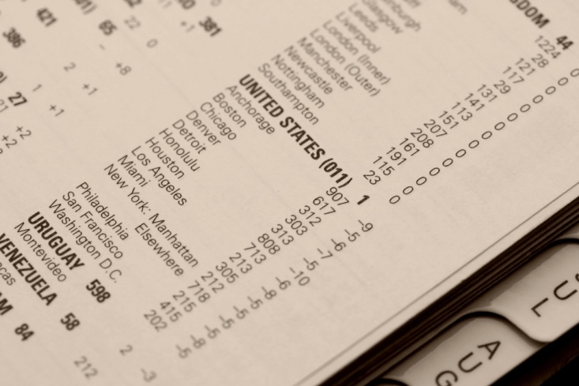
4.1 Greet guest and determine call to be made
Determine the call:
What country is it in?
What number?
Person to talk to
Where are you?
Notes:
Demonstrate what questions need to be asked to place a call for a guest.

Slide 31
4.2 Obtain required telephone number and details of business/person to be called
Outgoing calls – Obtaining numbers:
Directories:
Internal
Client
External directories
Notes:
Discuss the directories that can be used to find a number.

Slide 32
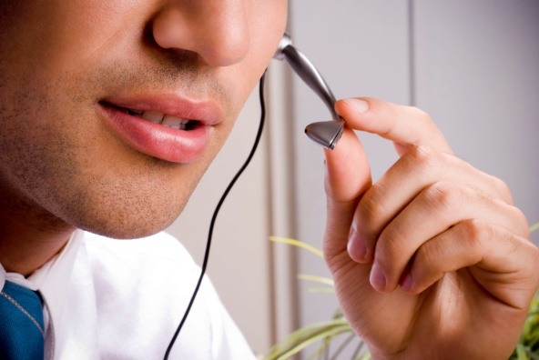
4.3 Place call and establish contact with required business/person
Make sure you establish contact with the correct person:
Listen to who answers the call
Seek the required person
Notes:
Discuss placing a call and establishing contact with required person
Use your listening skills – ask questions.

Slide 33
4.4 Implement standard redial procedures as required
Implement standard redial procedures:
Redial
Automatic redial
Notes:
Discuss the use of redial and automatic dialing.

Slide 34
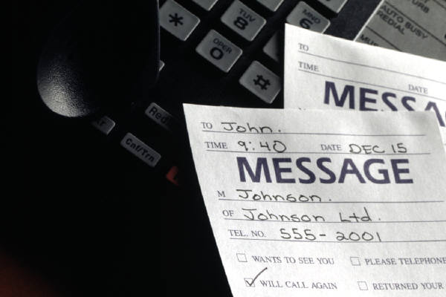
4.5 Log details of call in accordance with enterprise procedures
Log calls for:
Date and time of call
Details of international calls
Name of business/person called
Duration of call
Guest name and room number
Notes:
Discuss the reason for logging calls and the importance of the information staying confidential.

Slide 35

4.6 Cost guest call for posting to account
How are calls charged?
Posting charges to a guest account
Automatic posting via PMS
Notes:
Discuss how guests are charged for their calls – include surcharges
How to cost guests to the guest folio – computerized and manual.

Slide 36
End of unit Thank you.
Notes:
Trainer concludes this unit and thanks trainees for their attention and participation.

